Slide 1
Projectile motion including drag and spin
William Willmon
Dr. McDermott
Pacific University
9 March 2018

Slide 2
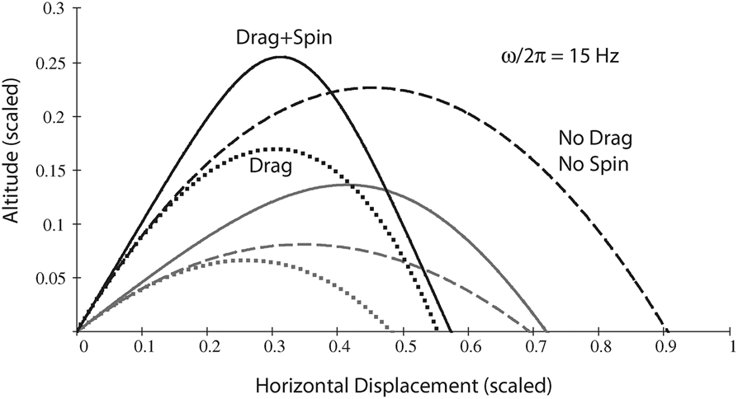

Modeling With drag and spin
Drag applies a force that creates a negative change in velocity
Spin can affect the path the object travels by adding extra acceleration

Slide 3
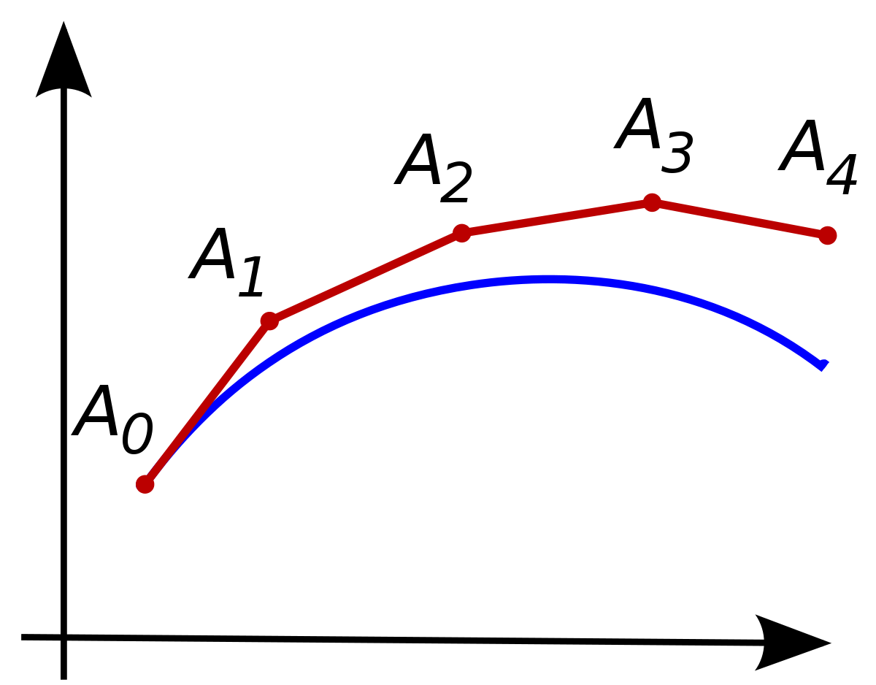
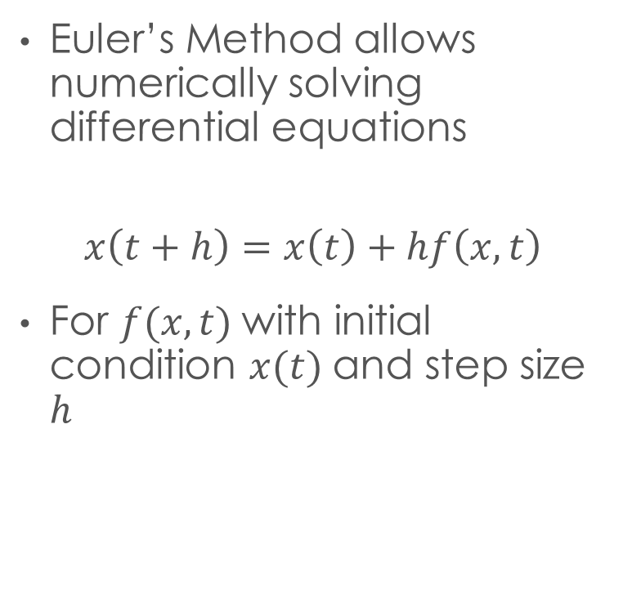
Euler’s Method
Euler’s Method allows numerically solving differential equations
$$x\left(t+h\right)=x\left(t\right)+hf\left(x,t\right)$$
For $f(x,t)$with initial condition $x(t)$and step size $h$

Slide 4
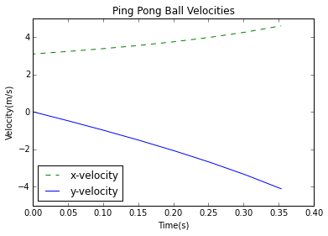
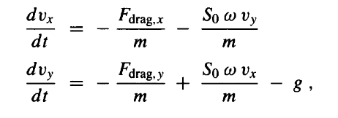
Euler’s Method Ping-Pong Ball
Use Euler’s equation and acceleration to graph velocity vs time

Slide 5
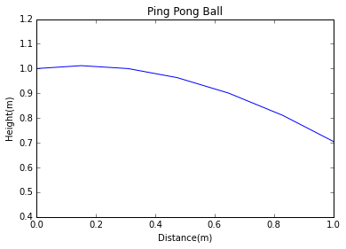
Trajectory of Ping-Pong Ball
Trapezoidal rule to find positions based on velocity graphs
θ = 9 degrees
v_{o} = 3 m/s

Slide 6
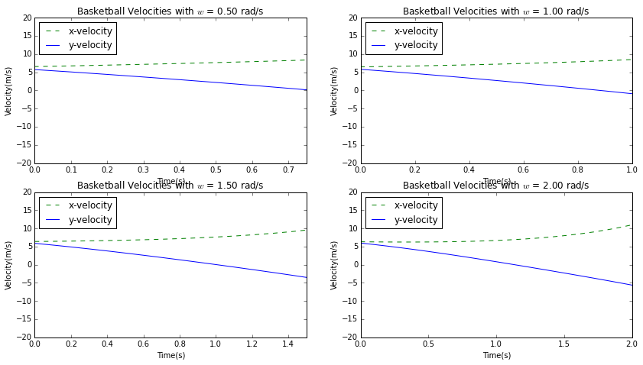
Effect of Backspin on basketball
Four different cases tested
Backspin of 0.5, 1.0, 1.5, 2.0 rad/s
Backspin creates acceleration in velocities

Slide 7
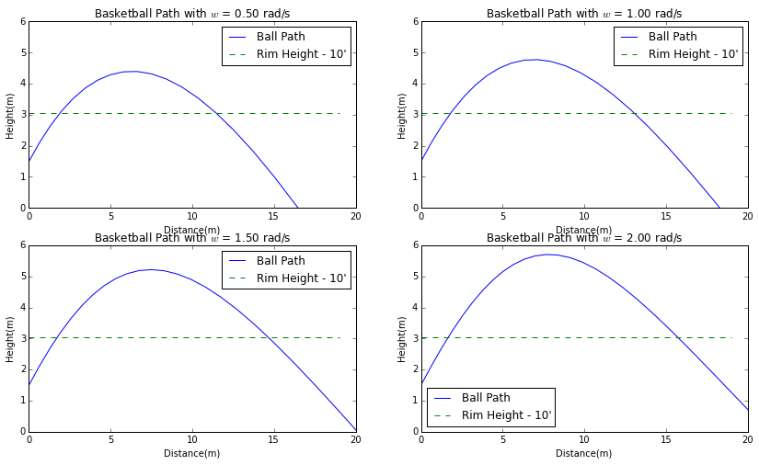
Trajectory based on backspin
θ = 45 degrees
v_{o} = 9 m/s
Increases height and distance

Slide 8

Thank you
Dr. Danielle McDermott
Dr. Andrew Dawes
Computational Students
http://tutorial.math.lamar.edu/Classes/DE/EulersMethod.aspx
http://www.inpredictable.com/2015/08/kind-of-drag.html
http://www.uphysicsc.com/2011-GM-B-379.PDF
Mark Newman, Computational Physics
Giordano, Ch 2 Realistic Projectile Motion

